Slide 1

Connecting Databases

Slide 2
Chapters
1. Benefits of Using Databases
2. What is a Relational Database?
3. Query Designing
4. Connect to DBs via File:Open

Slide 3
Benefits of Using Databases
Why should I connect to a database?
Data Integrity
Data is stored & protected throughout sample’s life-cycle
Governs permissions for who is allowed to manipulate test data
Extensibility
Allows you to add additional features to DB at any time with no down time.
Company can create business intelligence by assay data produced
Scalability
Client can continue to add multiple instruments to their existing model
Data Organization
Databases can “Normalize” data and reduce redundancy.
Great solution for large amount of data needed to record
Enhanced Error Recovery
If built, DBs allow you to track sample progress throughout assay.
Notes:
Integrity –Broad term.
Here we mean how data is stored and saved in a DB
Ensures data retrieved is the same as when it was recorded (throughout the data’s life-cycle)
Scalability – Same data source for all
Offers the ability for many instruments to access the data at once
Model grows as the customer grows in size and production
Self-Generating Worklisting – Safer, cleaner alternative to files
Eliminate need for end-user to type out worklists (reduces human error)
Imagine : Scan input sample barcodes, query DB for necessary data to create worklist, create sequences on-the-fly

Slide 4
Let’s talk about…
1. Benefits of Using Databases
2. What is a Relational Database?
3. Query Designing
4. Connect to DBs via File:Open

Slide 5
RDBs = Relational Databases
Important concepts about Relational Databases:
All data is stored in tables and tables are given names (ex. Job table)
Attribute = data column
Tuple = data row = record
Table created from query = result set
Rules can be established for each attribute (Domain Integrity)
AUTO INCREMENT, NOT NULL, VARCHAR(15), INT, BOOL, etc.
Tables should store same type of data (Data Normalization)
Data tables “relate” to one another via Primary and Foreign Keys
Primary keys can be used to establish distinction (Entity Integrity)
Keys can maintain relationships between tables (Referential Integrity)
Users can create queries at run-time that group separate data tables together using these primary/foreign key relationships.

Slide 6
RDBs = Relational Databases
Job Table
Worklist Table
Assay Table
job_id | barcode | assay
1 | 10001 | HIV
2 | 10002 | HBV
id | well_id | job_id
1 | A1 | 1
2 | A2 | 1
3 | H1 | 2
4 | H12 | 2
assay | big_dye_vol
HIV | 5
HBV | 10
Primary Key
Foreign Key
Primary Key
Foreign Key

Slide 7
Speaking T-SQL
1. Benefits of Using Databases
2. What is a Relational Database?
3. Query Designing
4. Connect to DBs via File:Open

Slide 8
Querying a single table (SQL Format):
READ: SELECT * FROM job WHERE assay = ‘HBV’;
SELECT barcode FROM job WHERE assay = ‘HBV’;
WRITE: INSERT INTO job (barcode, assay)
VALUES (10003, HBV); *Example of id column being an AUTO INCREMENT
UPDATE: UPDATE assay SET big_dye_vol = 10 WHERE assay=HIV;
DELETE: DELETE FROM worklist WHERE id = ‘4’
AND job_id = ‘2’;
WHEN DELETING, IF WHERE CLAUSE NOT PRESENT, ENTIRE TABLE IS GONE

Slide 9
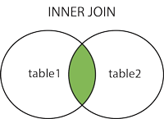
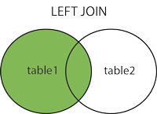
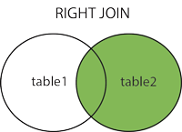
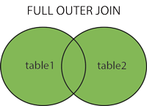
Querying MULTIPLE tables (SQL Format):
WE USE JOINS TO QUERY MULTIPLE TABLES: 4 TYPES
Selects all rows from both tables as long as there is a match between the columns in both tables.
SELECT table1.column1, table2.column2
FROM table1 JOIN table2 ON table1.column_name=table2.column_name;
*NOTE: You begin using <table>.<column>
Selects all rows from the left table (table1), with the matching rows in the right table (table2). The result is NULL in the right side when there is no match.
SELECT table1.column1, table2.column2
FROM table1 LEFT JOIN table2 ON table1.column_name=table2.column_name;
Selects all rows from the right table (table2), with the matching rows in the left table (table1). The result is NULL in the left side when there is no match.
SELECT table1.column1, table2.column2
FROM table1 RIGHT JOIN table2 ON table1.column_name=table2.column_name;
Selects all rows from the right table (table2), with the matching rows in the left table (table1). The result is NULL in the left side when there is no match.
SELECT table1.column1, table2.column2
FROM table1 FULL OUTER JOIN table2 ON table1.column_name=table2.column_name;
I MOST COMMONLY USE THIS TYPE FOR HAMILTON INTEGRATION

Slide 10
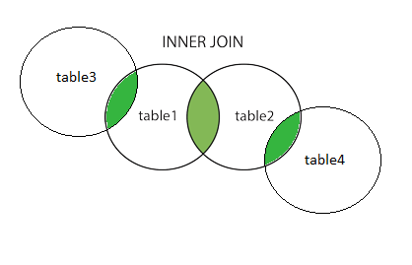
Querying MULTIPLE tables (SQL Format):
WE USE JOINS TO QUERY MULTIPLE TABLES: 4 TYPES
If you want to connect more than 2 table, simply add more JOINS to the query!
Selects all rows from both tables as long as there is a match between the columns in both tables.
SELECT table1.column1, table2.column2
FROM table1 JOIN table2 ON table1.column_name=table2.column_name;
*NOTE: You begin using <table>.<column>
SELECT t1.column, t2.column, t3.column, t4.column
FROM table1 AS t1 JOIN table2 AS t2 ON t1.column_name=t2.column_name
JOIN table3 AS t3 ON t1.column_name=t3.column_name
JOIN table4 AS t4 ON t2.column_name=t4.column_name
WHERE t1.some_column = value;
Tired of typing the table names all the time?! Use an “ALIAS” and give it a nickname with “…AS [alias]”!

Slide 11
Querying a Worklist
Table: job
Table: worklist
Table: assay
job_id | barcode | assay
1 | 10001 | HIV
2 | 10002 | HBV
id | well_id | job_id
1 | A1 | 1
2 | A2 | 1
3 | H1 | 2
4 | H12 | 2
assay | big_dye_vol
HIV | 5
HBV | 10
Let’s say your protocol just scanned your pcr plate: Barcode read was 10001
RESULT SET
SELECT w.well_id, a.big_dye_vol
FROM worklist AS w
well_id | big_dye_vol
A1 | 5
A2 | 5
JOIN job AS j ON w.job_id = j.job_id
JOIN assay AS a ON j.assay = a.assay
WHERE j.barcode = ‘10001’

Slide 12
Other types of Queries (SQL Format):
Alternate to JOIN using in OR not in (Oracle)
select se.sequence_name, se.id_sequence, si.s_id_lida, f.id_fraction, f.id_sample, si.s_name, f.f_vialbarcode, f.f_keep, f.f_vialtare, f.f_pos2, f.f_processed1, f.f_processed2, f.f_volume, f.f_weight, si.s_mass from fraction f, sample_in si, sequence se where se.id_sequence in
(select distinct se.id_sequence from fraction f, sample_in si, sequence se where f.f_rackbarcode2 = 'srv002008' and f.f_weight != 0 and f.f_keep = 1 and f.f_volume > 0 and f.f_processed1 = 1 and f.f_processed2 = 0 and f.id_sample = si.id_sample and se.id_sequence = si.id_sequence)
and f.f_keep = 1 and f.id_sample = si.id_sample and si.id_sequence = se.id_sequence order by f.f_pos2
Result: 15 different fields of data based on ten different selection criteria across 3 different tables from 1 barcode.
Data Conversion with SQL
select to_char(smiles(m.ctab)) as smile_str from lida_medchem_results r, lida_medchem_moltable m where r.cdbregno = 49909 and r.cdbregno = m.cdbregno
Result: smile string value CCN(C)Cc1ccc(cc1)NC(=O)c2ccc3c(c2)n(cn3)C from ISIS nomenclature in column m.ctab.
select hex(dp_select.cst) as tempA from dp, dp_select where dp.p = dp_select.p and dp.name = ‘QX4087653’
Result: customer number as hexadecimal value, later converted to integer to solve issue of leading zeroes. (004 vs. 4)

Slide 13
Using Venus to Connect
1. Benefits of Using Databases
2. What is a Relational Database?
3. Query Designing
4. Connect to DBs via File:Open

Slide 14
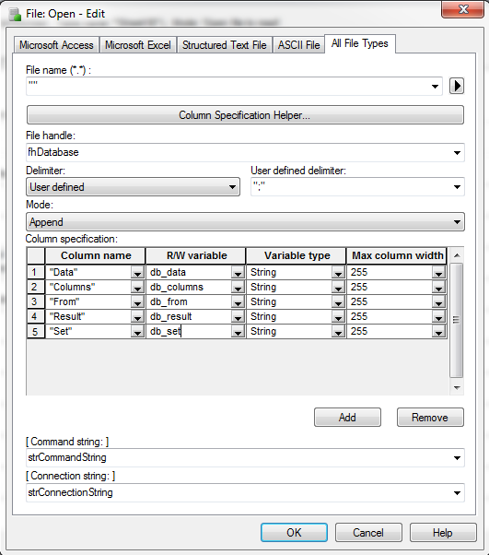
Connect to DBs via File:Open
Things Needed:
Image. Recommended size: 4.7 inches square (12 cm square), 72 dpi or greater
Connection String
Command String
Column Specification from Result Set
(discussed in query design)

Slide 15
Connect to DBs via File:Open
What is a Connection String?
String of attributes needed to connect to a database
Consists of key-value pairs separated by a “;” and passed to a provider
Provider?
A provider is a software component that your application (ex. Hamilton method) uses to interact directly with your data source.
What does the connection string require?
Data source (SQL Server, Oracle, MySQL, PostgreSQL, etc.)
Data provider (SQLOLEDB, MyOracleDB)
Security Options (Use username/password or Windows Authentication)

Slide 16


Connect to DBs via File:Open
Connection String Format (SQLServer Example)
For more information, visit www.connectionstrings.com

